Slide 1
Organizational Strategy, Competitive Advantage, and Information Systems
Chapter 2

Slide 2
LEARNING OBJECTIVES
1. Discuss ways in which information systems enable cross-functional business processes and business processes for a single functional area.
2. Differentiate between business process reengineering, business process improvement, and business process management.
3. Identify effective IT responses to different kinds of business pressures.
4. Describe the strategies that organizations typically adopt to counter Porter’s five competitive forces.

Slide 3




Market leaders
A sustainable advantage over competitors that enables them to capture the market

Slide 4
Introduction
Can you just discuss the best digital strategy these companies created in the last 10 years?
- Apple
- Facebook
- Microsoft
- Google

Slide 5
Introduction
Information systems (ISs) are critically important in helping organizations respond to business pressures and in supporting organizations’ global strategies.
Competitive Advantage refers to any assets that provide an organization with an edge against its competitors in some measure such as cost, quality, or speed. A competitive advantage helps an organization to control a market and to accrue larger-than-average profits.
Significantly, both strategy and competitive advantage take many forms.

Slide 6
Crafting Strategies
Represents a managerial commitment to pursuing an array of choices about how to compete:
How to create products that will attract and please
How to position the company in the industry
How to deploy resources to build value
How each function will be operated
How to achieve performance targets

Slide 7
Business Processes
A Business Process is an on-going collection of related activities that create a product or a service of value to the organization, its business partners, and/or its customers.
The process involves three fundamental elements:
• Inputs: Materials, services, and information that flow through and are transformed as a result of process activities
• Resources: People and equipment that perform process activities
• Outputs: The product or a service created by the process

Slide 8
Successful organizations
Successful organizations measure their process activities to evaluate how well they are executing these processes.
Two fundamental metrics that organizations employ in assessing their processes are efficiency and effectiveness.
Efficiency focuses on doing things well in the process; for example, progressing from one process activity to another without delay or without wasting money or resources.
Effectiveness focuses on doing the things that matter; that is, creating outputs of value to the process customer—for example, high-quality products.

Slide 9
Business Processes
How can an organization’s business processes can create a competitive advantage?

Slide 10
Business Processes
How can an organization’s business processes can create a Competitive Advantage?
If they enable the company to innovate or to execute more effectively and efficiently than its competitors
Make the company less responsive and productive.
Example : Airline Industry
What are the competitive necessities?
- To attract customers and increase revenues
Cost Advantage Differentiation Advantage

Slide 11
Airline Industry
An up-to-date, user-friendly site
Should provide fast answers to user queries
Electronic ticket purchases via their Web sites
these sites must be highly responsive
they must provide both current and accurate information on flights and prices.
In contrast, a site that provides outdated or inaccurate information, or has a slow response time, will hurt rather than improve business.

Slide 13
Airline Industry
What are the inputs?
What are the outputs?
What are the resources?
How to measure the performance?
How the process creates customer value?
Efficiency metrics ?
Effectiveness metrics ?

Slide 14
Cross-Functional Processes
Many business processes fall within a single functional area of the company
Cross-functional Business Processes cut across multiple functional areas;
meaning that no single functional area is responsible for their execution.
multiple functional areas collaborate to perform the process
For a cross-functional process to be successfully completed, each functional area must execute its specific process steps in a coordinated, collaborative way.

Slide 15
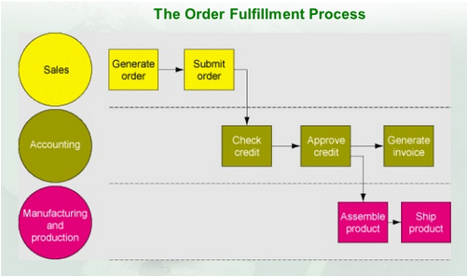
Cross-Functional Processes
Cut across multiple functional areas;
Multiple functional areas collaborate to perform the process;
No single functional area is responsible for their execution.
e.g., procurement and fulfillment.

Slide 16
Good Business Processes
Good business processes are vital to organizational success
But how can organizations determine if their business processes are well designed?
Document: The first step is to document the process by describing its steps, its inputs and outputs, and its resources.
Analyse: The organization can then analyze the process
Measure
Modify if necessary to improve its performance
Innovate

Slide 17
Examples of Business Processes

Slide 18
Examples of Business Processes

Slide 19

IS enabled Business Processes
Information Systems (IS):
A critical enabler of business processes.
Facilitate communication and coordination among different functional areas.
Allow easy exchange of, and access to, data across processes.
IS’ vital role in 3 areas: Could be fully automated
Executing the process
Capturing and storing process data: e.g., RFID
Monitoring process performance
For example: e-commerce as a set of the Internet-enabled business processes: https://www.youtube.com/watch?v=AhgtoQIfuQ4

Slide 20
Information Systems and Business Processes
Information systems facilitate communication and coordination among different functional areas, and allow easy exchange of, and access to, data across processes. Specifically, ISs play a vital role in three areas:
• Executing the process
• Capturing and storing process data
• Monitoring process performance

Slide 21
Executing the Process.
An IS helps organizations execute processes efficiently and effectively.
ISs are typically embedded into the processes, and they play a critical role in executing the processes.
For example, In the procurement process, the IS generates the purchase requisitions and then informs the purchasing department that action on these requisitions is needed.
The accountant will be able to view all shipments received to match an invoice that has been received from a supplier and verify that the invoice is accurate.

Slide 22
Capturing and Storing Process Data.
ISs capture and store data, commonly referred to as process data or transaction data.
Some of these data are generated and automatically captured by the IS.
Other data are generated outside the IS and must be entered into it.
For example, when a customer order is received by mail or over the phone, the person taking the order must enter data such as the customer’s name, what the customer ordered, and how much he or she ordered. Significantly, when a customer order is received via the firm’s Web site, then all customer details are captured by the IS.

Slide 23
Capturing and Storing Process Data
An important advantage of using an IS compared to a manual system or multiple functional area information systems is that the data need to be entered into the system only once.
Further, once they are entered, other people in the process can easily access them, and there is no need to re-enter them in subsequent steps.
The data captured by the IS can provide immediate feedback.
For example, the IS can use the data to create a receipt or to make recommendations for additional or alternative products.

Slide 24
Monitoring Process Performance
A third contribution of IS is to help monitor the state of the various business processes. That is, the IS indicates how well a process is executing. The IS performs this role by evaluating information about a process.
This information can be created either at the instance level (i.e., a specific task or activity) or at the process level (i.e., the process as a whole).
Examples?

Slide 25
Monitoring Process Performance
For example, a company might be interested in the status of a particular customer order.
Where is the order within the fulfilment process?
Was the complete order shipped? If so, when? If not, then when can we expect it to be shipped?
For the procurement process,
when was the purchase order sent to the supplier?
What will be the cost of acquiring the material?

Slide 26
Questions
What is a business process?
Describe several business processes carried out at your university.
Define a cross-functional business process, and provide several examples of such processes.
Pick one of the processes described in question 2 or 3 above, and identify its inputs, outputs, customer(s), and resources. How does the process create value for its customer(s)?

Slide 27

BP Reengineering (BPR)
A strategy for making an organization’s business processes more productive and profitable.
Examining business processes;
Determining how they can best reconstruct those processes to improve their business functions.
Difficult, radical, and comprehensive to do.

Slide 28
Business Process Reengineering
Excellence in executing business processes is widely recognized as the underlying basis for all significant measures of competitive performance in an organization
Consider the following measures, for example:
• Customer satisfaction: The result of optimizing and aligning business processes to fulfil customers’ needs, wants, and desires.
• Cost reduction: The result of optimizing operations and supplier processes.
• Cycle and fulfilment time reduction: The result of optimizing the manufacturing and logistics processes.
• Quality: The result of optimizing the design, development, and production processes.
• Differentiation: The result of optimizing the marketing and innovation processes.
• Productivity: The result of optimizing each individual’s work processes.

Slide 29
How does an organization ensure business process excellence?
In their book Reengineering the Corporation,(1993), Michael Hammer and James Champy argued that to become more competitive, American businesses needed to radically redesign their business processes to reduce costs and increase quality.
The authors further asserted that information technology is the key enabler of such change. This radical redesign, called business process reengineering (BPR), is a strategy for making an organization’s business processes more productive and profitable.
The key to BPR is for enterprises to examine their business processes from a “clean sheet” perspective and then determine how they can best reconstruct those processes to improve their business functions.
BPR’s popularity was propelled by the unique capabilities of information technology, such as
automation and standardization of many process steps and
error reduction due to improved communication among organizational information silos.

Slide 30
BP Reengineering (BPR)
A strategy for making an organization’s business processes more productive and profitable.
Examining business processes;
Determining how they can best reconstruct those processes to improve their business functions.
Difficult, radical, and comprehensive to do.

Slide 31
BPI - business process improvement
The businesses increasingly began to organize work around business processes rather than individual tasks. The result was a less radical, less disruptive, and more incremental approach, called business process improvement (BPI).
BPI focuses on reducing variation in the process outputs by searching for root causes of the variation in the process itself

Slide 32
5 Basic Phases of BPI
Define problems
Measure data and metrics
Analyze "as-is" process, id problems, and root causes
Improve by mapping "to-be" process and implementing solution
Control & ensure process remains stable
BPI is usually performed by teams of employees that include a process expert—usually the process owner (the individual manager who oversees the process)—as well as other individuals who are involved in the process.

Slide 33
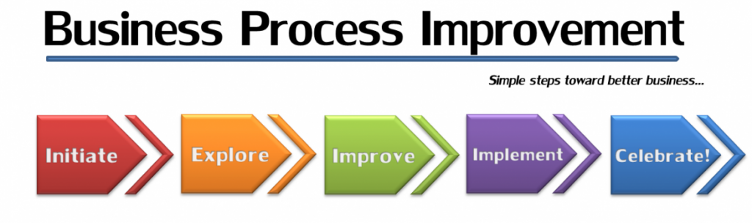
BP Improvement (BPI)
BP Improvement (BPI)
Focuses on reducing variation in the process outputs: Streamline your business
Searching for root causes of the variation in the process (such as a broken machine on an assembly line) or among the process inputs (such as a decline in the quality of raw materials purchased from a certain supplier).
Less radical; less disruptive; more incremental.
33

Slide 34
BPI
Six Sigma is a popular methodology for BPI initiatives. Its goal is to ensure that the process has no more than 3.4 defects per million outputs by using statistical methods to analyze the process.
Many organizations prefer BPI because
They are less risky and less costly
BPI projects take less time overall, and even if they are unsuccessful, they consume fewer organizational resources than BPR projects.
BPI projects tend to be performed more from the bottom-up, in contrast to BPR projects that involve top-down change mandates.
BPI focuses on delivering quantifiable results

Slide 35
business process management
Organizations can adopt business process management (BPM), a management system that includes methods and tools to support the design, analysis, implementation, management, and continuous optimization of core business processes throughout the organization.
BPM integrates disparate BPI initiatives to ensure consistent strategy execution
Important components of BPM are
Process modeling,
Web-enabled technologies, and
Business activity monitoring

Slide 36
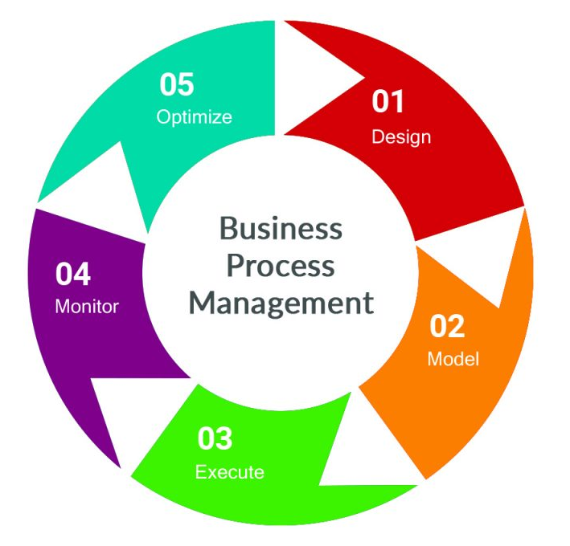
BP Management (BPM)
A management system designed to sustain BPI efforts over time;
Includes methods and tools to support the design, analysis, implementation, management, and continuous optimization of core BP throughout the organization;
Integrates disparate BPI initiatives to ensure consistent strategy execution.

